Slide 1

Supply Chain Dataset Analysis
Names
1-Shaimaa
2-Hager
3-Nehal Samir
4-Noor
5-Mohammed

Slide 2
Content
Content
1- Overview
2-Data cleaning
3- Analysis by Python
a-Statistical analysis b- Top Revenue Generated
c- Best-selling Products d- Shipping Insights
e- Defect Rates f- Availability & Stock Levels
g-Supplier Performance
4-Analysis by Tableau
a-Sales Performance B-Operation analysis
C-Inventory management d- Logistics Performance: Shipping Insights
e-Shipping Key Insights and Recommendations f-Supplier Efficiency
5- Recommendations

Slide 3
Overview
1.Product Types: The dataset includes three main product types: haircare, skincare, and cosmetics.
2.Revenue Generation: Each product has varying revenue, influenced by its price and the number of units sold.
3.Demographics: Customer demographics show a mix of male, female, and non-binary categories, which can help in targeting marketing strategies.

Slide 4
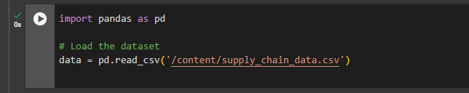
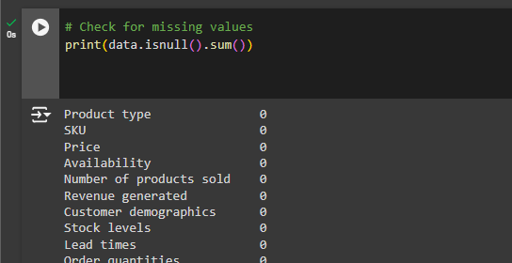
Data cleaning
Using Python
1
2

Slide 5
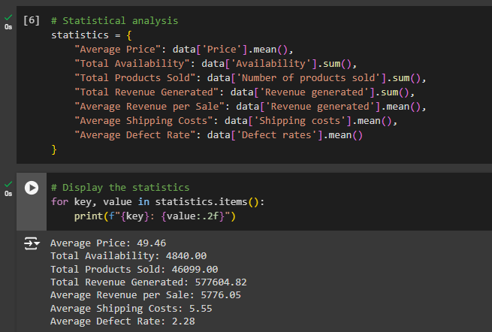
Statistical analysis
Using Python

Slide 6
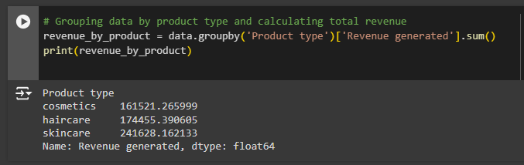
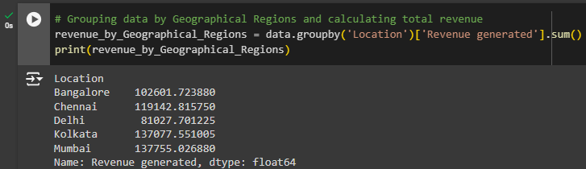
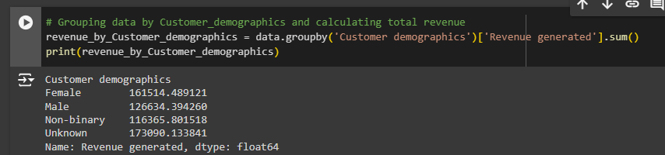
Revenue Analysis:
Using Python
1
Product Categories
2
Geographical Regions
3
Customer Segments

Slide 7
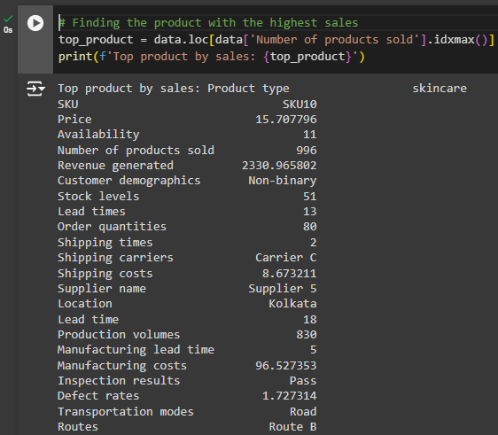
Best-selling Products

Slide 8
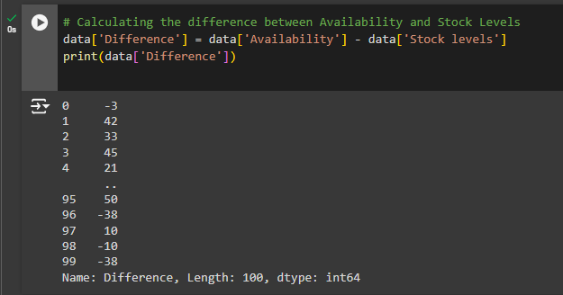
Availability" &"Stock Levels
Observations
• General Trend: On average, "Availability" exceeds "Stock Levels," indicating that products generally have more availability than stock.
• Discrepancies: Some entries show significant discrepancies, with a few cases where stock levels are much lower than availability.
• Low Stock: Notably, several entries have stock levels of 0 or very low (e.g., 1, 2), indicating potential issues with inventory management for those products

Slide 9
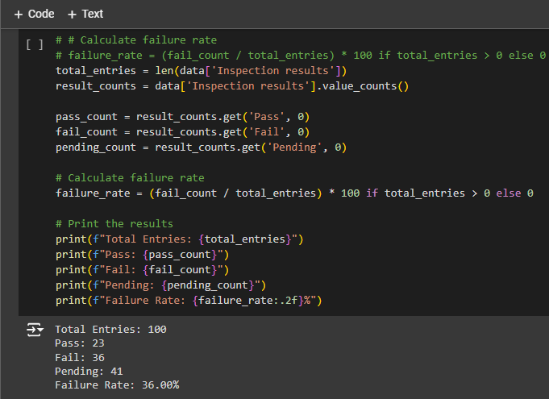
Inspection Results Overview
Total Entries: 100
Inspection Results Count:
Pass: 23
Fail: 36
Pending: 41
This shows a concerning 36% failure rate among the suppliers,
which indicates a significant quality issue that needs addressing.

Slide 10
Recommendations
By focusing on supplier quality, optimizing shipping methods, managing inventory effectively, and analyzing costs, we can improve overall product performance and customer satisfaction. Regular reviews of these factors will help adapt to changing market conditions.

Slide 11
Visualization by tableau

Slide 12
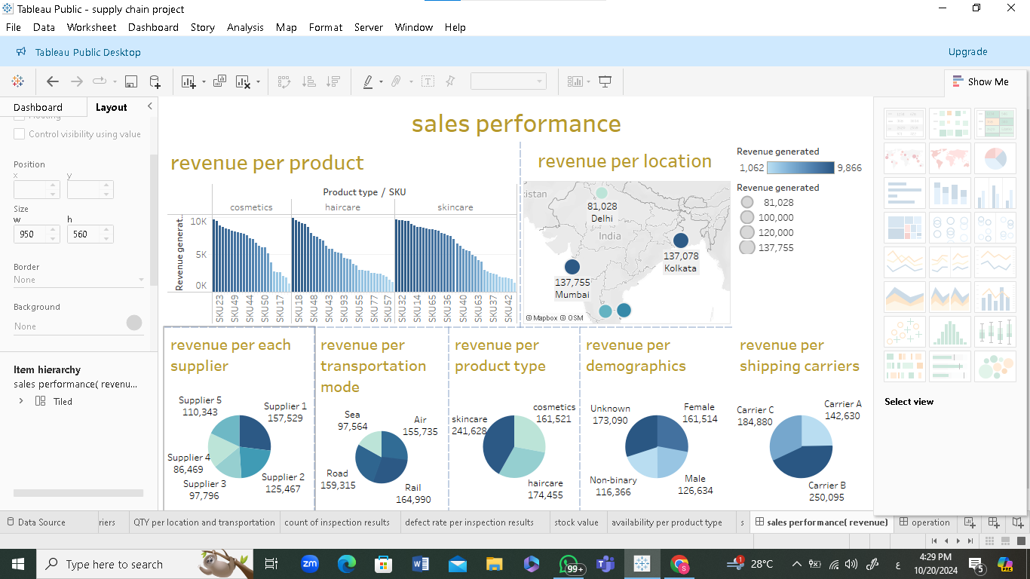
Revenue Analysis:(Sales Performance)

Slide 13
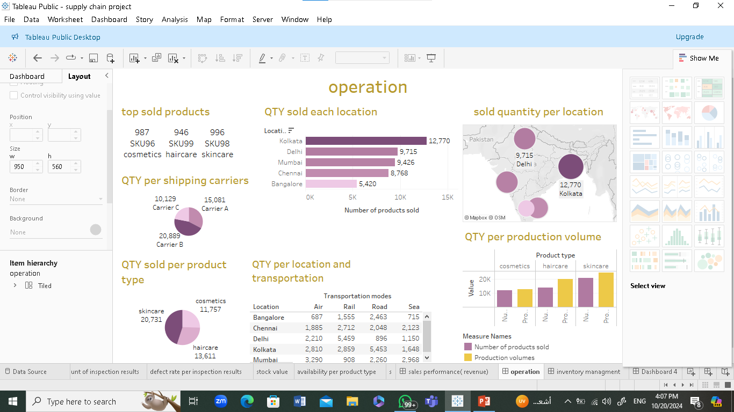
Operation Analysis

Slide 14
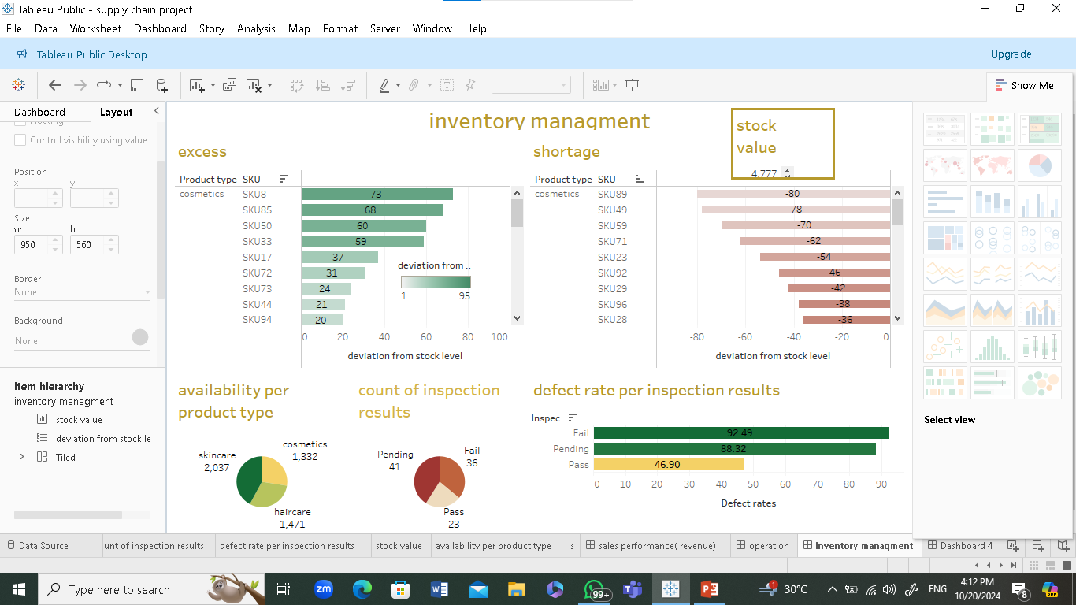
Inventory management

Slide 15
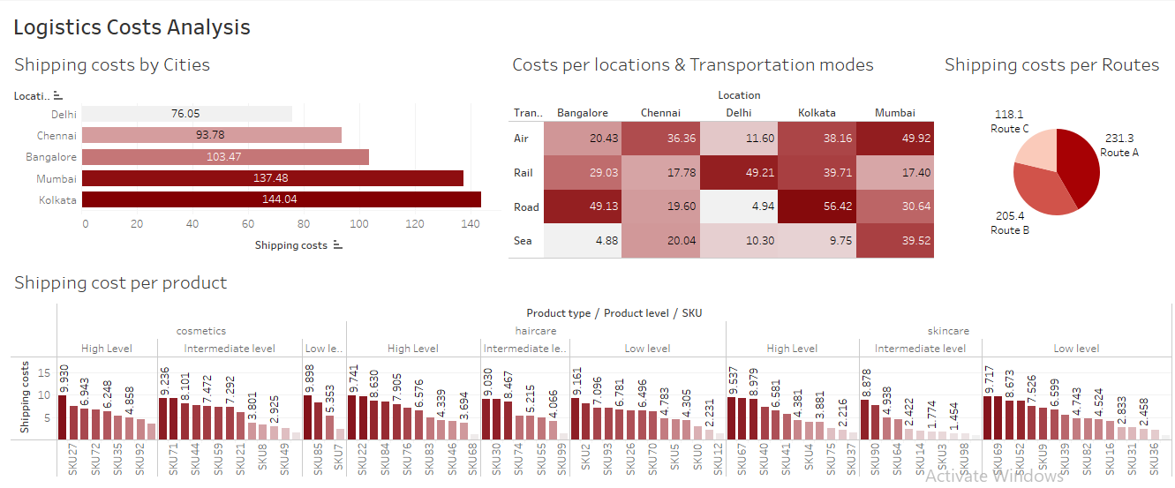
Logistics Performance: Shipping Insights

Slide 16
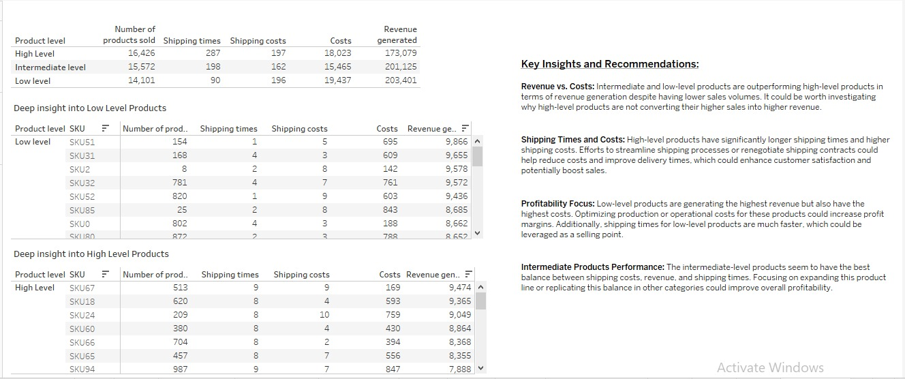
Logistics Performance: Shipping Key Insights and
Recommendations

Slide 17
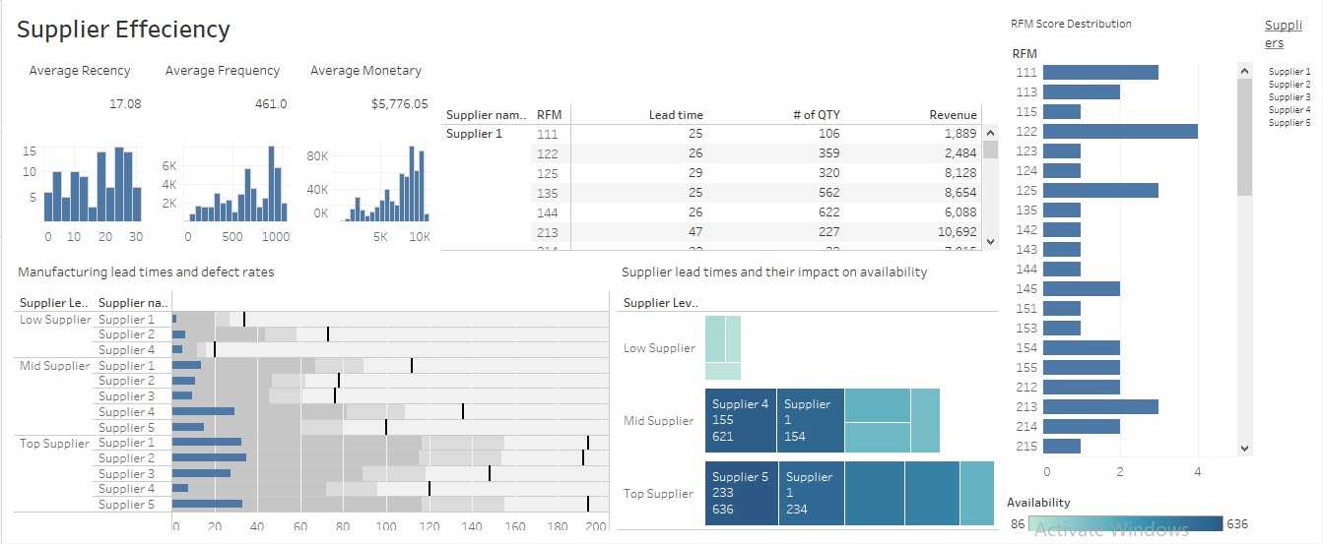
Supplier Efficiency

Slide 18


